Slide 1
RSA
Encryption
Course: CEP146 NBB
Project by:
Adrian Stanciu - Seneca Student ID: 111272266
Muffin Aybar - Seneca Student ID: 107362253
Summer Chang - Seneca Student ID: 148482243
Ignacio Morales Hermosilla - Seneca Student ID: 122079262

Slide 2
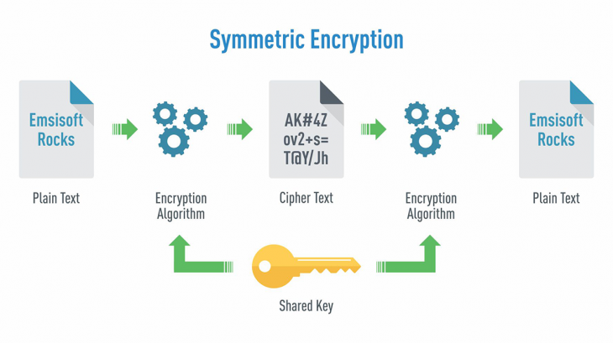
RSA Encryption
How They’re Used and Made
RSA Encryption is an asymmetric encryption algorithm.
It generates a key pair to encrypt and decrypt data.
Most common form of communication is two-way communication.
We achieve this by:
1. Make a key pair
2. Send our recipient the public key while keeping the private key
3. Recipient uses the public key to encrypt and send their own public key over
4. Use our own private key to decrypt their public key
This allows two-way secure information by allowing both to send and receive data.

Slide 3
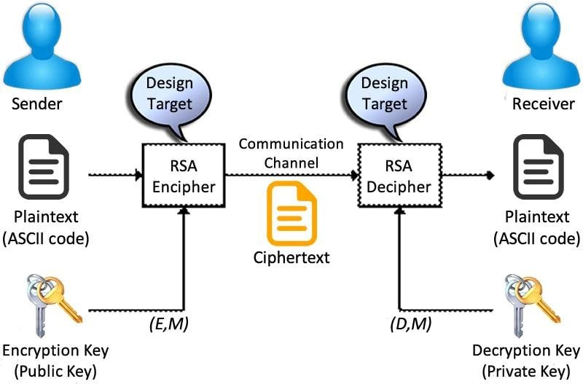
RSA Encryption
How They’re Used and Made

Slide 4
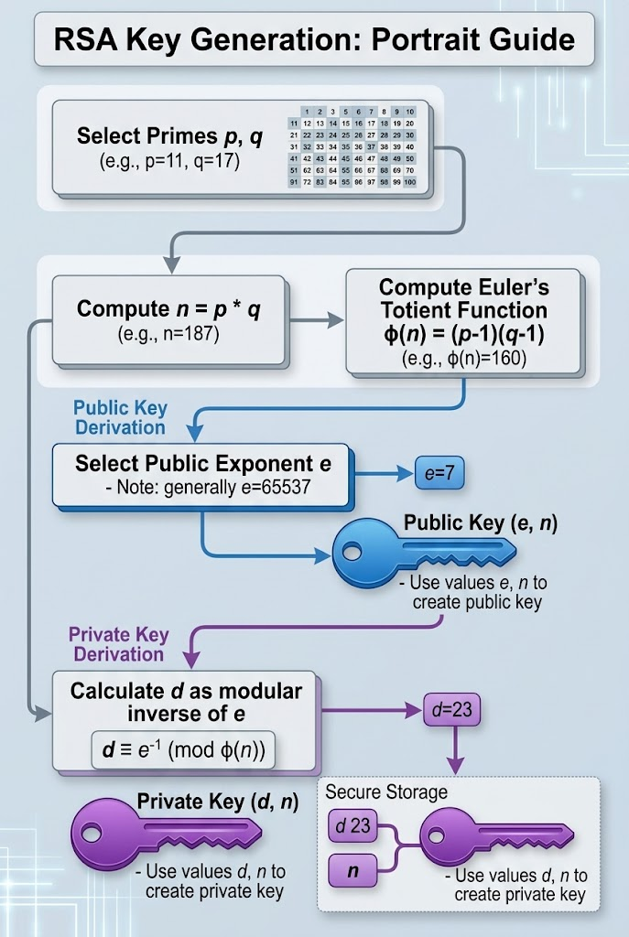
RSA Key Generation
Public and Private Keys
Generating keys involves two very large prime numbers.
This is done in UNIX systems by converting the output into a hexadecimal.
How big the number depends on how many bits are received from urandom.
Typical length is 2028 bits.
Public Key
Private Key
  Can be generated using “Euler’s Totient Function”
  Public exponent e is selected
  Exponent generally is 65537
  Now you can make public key using e and n (e, n)
  Private exponent “d”
  Calculate d as the modular inverse of e
  Private key is d and n (d, n)

Slide 5
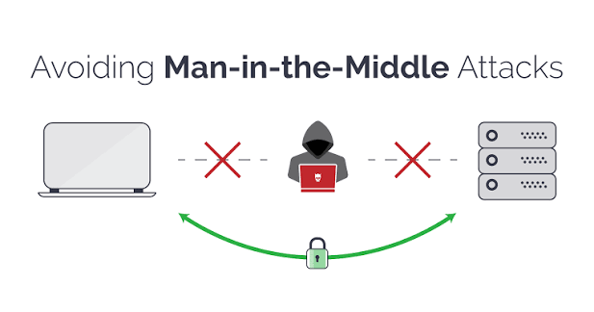
RSA Encryption
Practicality in the Real World
Certificates:
  Were come up by engineers
  Made to counter attackers intercepting public keys and sending/reading data
  Are digitally signed by a trusted Certificate Authority
  Allows the client to verify that the public key actually belongs to the server
  Is a binding of the public key to a domain, website, SSH connection or more

Slide 6
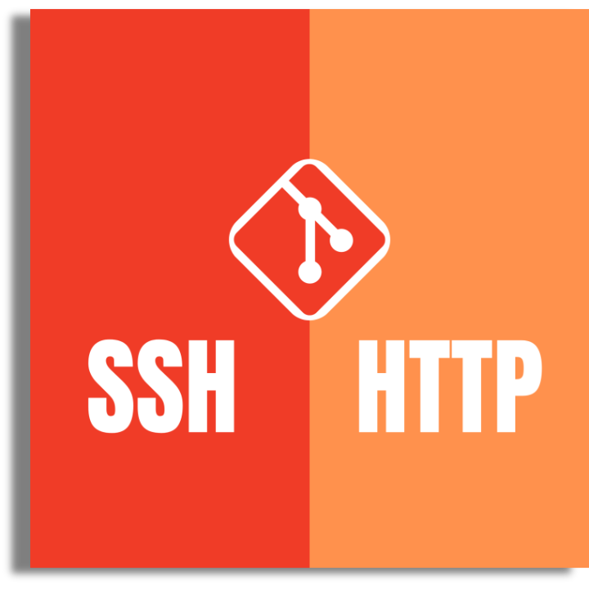
How RSA Works in the World
Real world Usage
  Send or receive data
  RSA is safer than https over public networks
  RSA uses a keypair
  You cannot derive public from private keys
  RSA over open networks are very secure
  Https authenticates websites using certificates
  Establishes a secure session
Another use is OpenSSH's ssh program.
It connects to a virtual terminal.

Slide 7
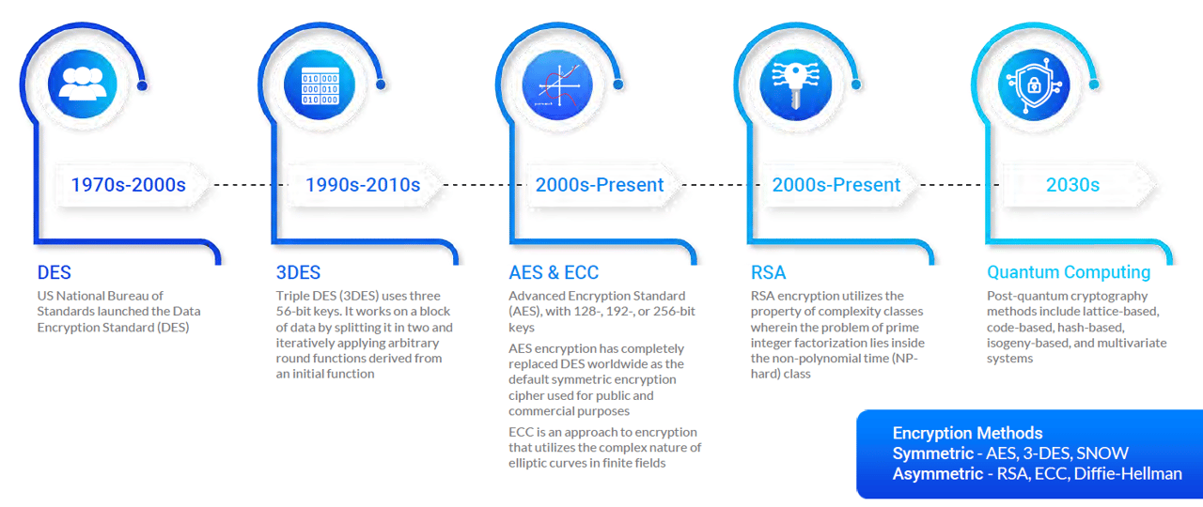
RSA Encryption
The Future

Slide 8
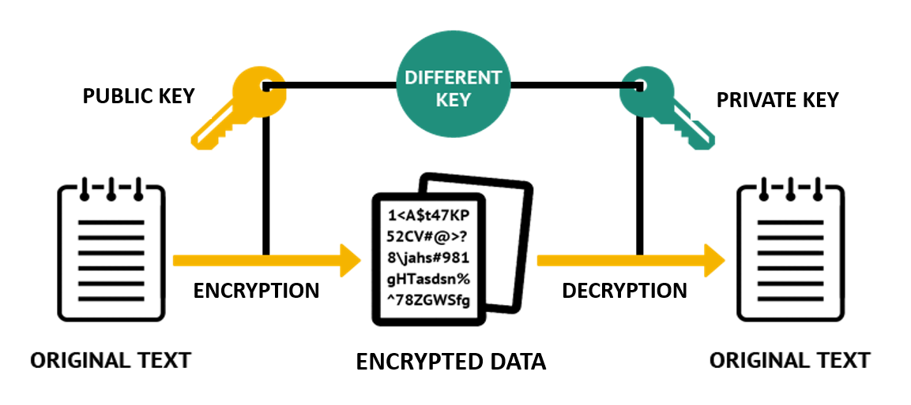
Closing Off

Slide 9
Bibliography
  David Ireland, DI Management Services Pty Limited, Australia, www.di-mgt.com.au. (n.d.). RSA Algorithm. Copyright (C) 2002-25 DI Management Services Pty Limited ABN 78 083 210 584 All Rights Reserved. https://di-mgt.com.au/rsa_alg.html
  GeeksforGeeks. (2025, July 23). RSA algorithm in cryptography. GeeksforGeeks.https://www.geeksforgeeks.org/computer-networks/rsa-algorithm-cryptography/
  Lebeaux, B., & Lebeaux, B. (2026, September 17). Setting the record straight on quantum computing and RSA encryption. RSA. https://www.rsa.com/resources/blog/zero-trust/setting-the-record-straight-on- quantum- computing-and-rsa-encryption/
  RSA Community. (n.d.). https://community.rsa.com/s/article/RSA-cryptography-and-NIST-guidance
  Tucker, A. (2024, September 30). RSA encryption: How the RSA algorithm works and why it matters. SecureW2. https://securew2.com/blog/what-is-rsa-asymmetric-encryption
  Understanding the SSH encryption and connection process | DigitalOcean. (n.d.). https://www.digitalocean.com/community/tutorials/understanding-the-ssh-encryption-and-connection- process

